Slide 1
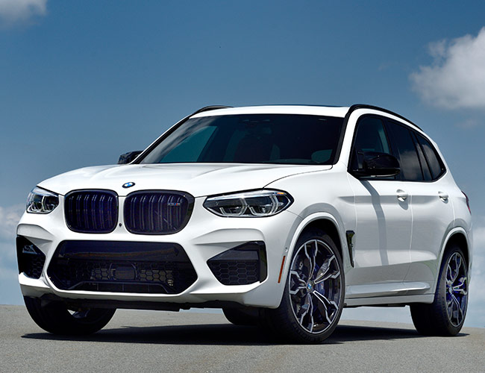
Conv2D + ReLU (filters=16)
MaxPooling2D
Conv2D + ReLU (filters=32)
MaxPooling2D
Conv2D + ReLU (filters=64)
MaxPooling2D
Flatten
Fully Connected + ReLU
softmax
Image 299x299

Slide 2
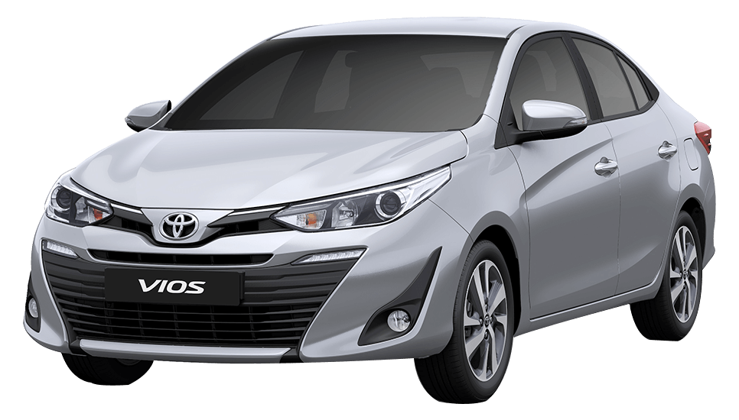


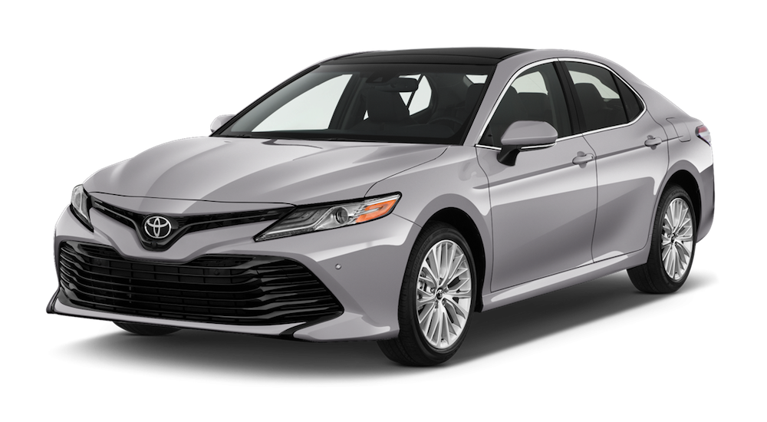
Car Image
Car Make
Car Model
Vios
Camry

Slide 3
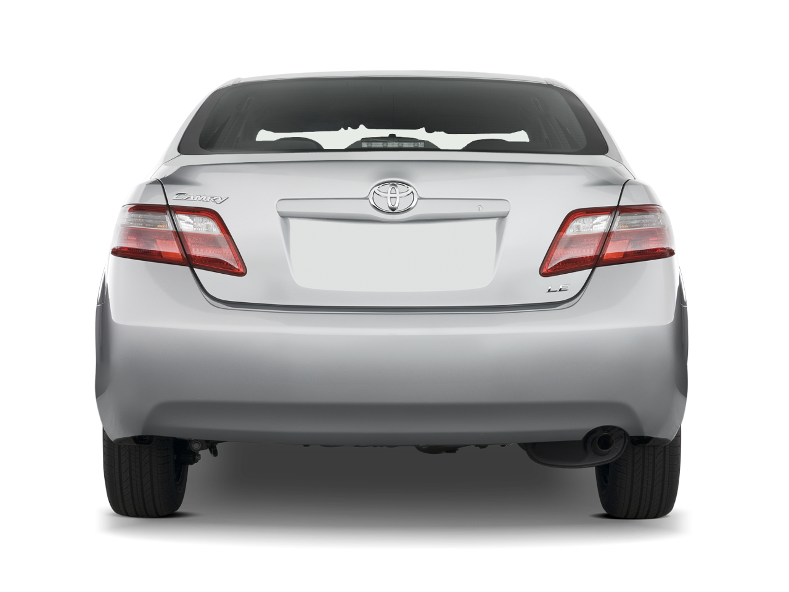
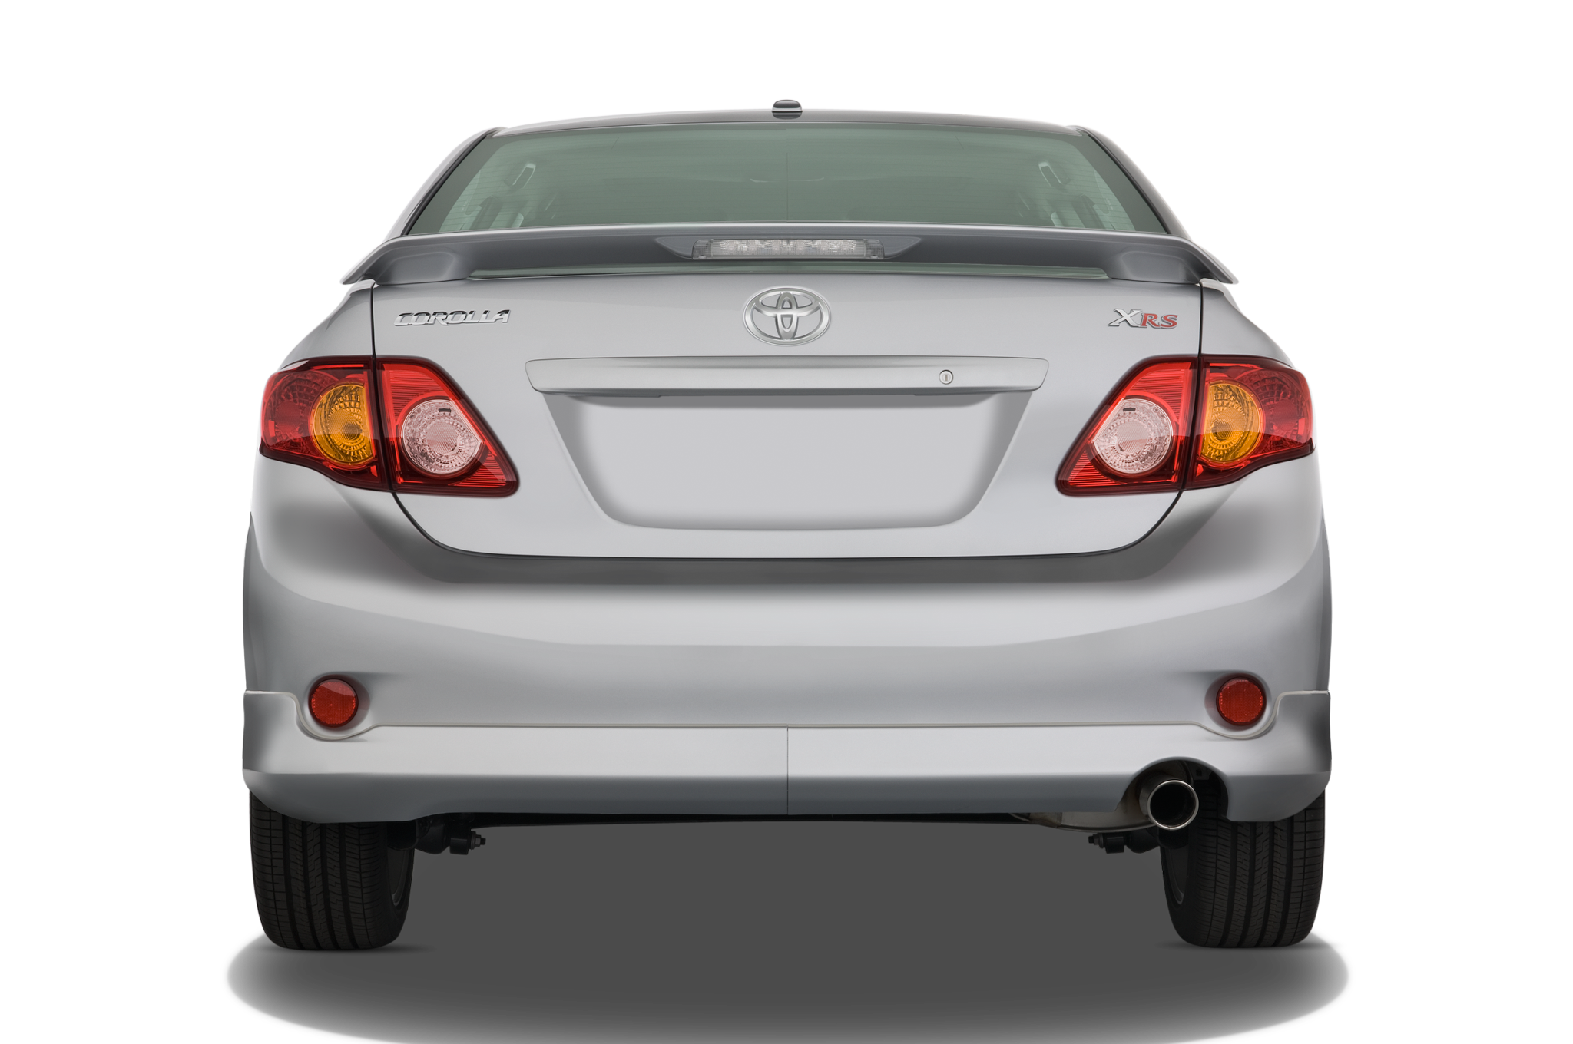
Car Image
Car Make
Car Model
Camry
Corolla

